Slide 1

Interactive Programs
Programs that get input from the user
In PowerPoint, click on the speaker icon then click the "Play" button to hear the narration.

Slide 2

Interactive Programs
Programs generally need input on which to operate - The Scanner class provides convenient methods for reading input values of various types.
A Scanner object can be set up to read input from various sources, including the keyboard.
Keyboard input is represented in Java by the System.in object.

Slide 3
Reading Keyboard Input
The following line creates a Scanner object that reads from the keyboard:
Scanner scan = new Scanner(System.in);
The new operator creates the Scanner object
Once created, the Scanner object can be used to invoke various input methods, such as:
answer = scan.nextLine();

Slide 4
Reading Keyboard Input
The nextLine method reads all of the input until the newline character (\n, end of the line) is found.
The Scanner class is part of the java.util class library, and must be imported into a program to be used
At the beginning of your program, write
import java.util.Scanner;

Slide 5

Input Tokens
Unless specified otherwise, white space is used to separate the elements (called tokens) of the input - White space includes space characters, tabs, new line characters.
The next method of the Scanner class reads the next input token and returns it as a string.
Methods such as nextInt and nextDouble read data of particular types.

Slide 6
//********************************************************************
// GasMileage.java Author: Lewis/Loftus
//
// Demonstrates the use of the Scanner class to read numeric data.
//********************************************************************
import java.util.Scanner;
public class GasMileage
{
//-----------------------------------------------------------------
// Calculates fuel efficiency based on values entered by the
// user.
//-----------------------------------------------------------------
public static void main (String[] args)
{
int miles;
double gallons, mpg;
Scanner scan = new Scanner (System.in);
continue
Copyright © 2012 Pearson Education, Inc.

Slide 7
continue
System.out.print ("Enter the number of miles: ");
miles = scan.nextInt();
System.out.print ("Enter the gallons of fuel used: ");
gallons = scan.nextDouble();
mpg = miles / gallons;
System.out.println ("Miles Per Gallon: " + mpg);
}
}
Copyright © 2012 Pearson Education, Inc.

Slide 8
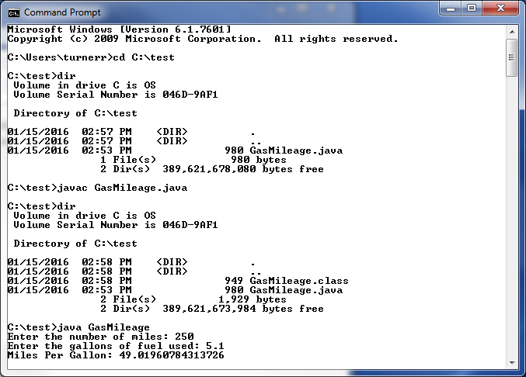
Running GasMileage

Slide 9
Readings and Assignments
Reading: Chapter 2.1-2.4, 2.6
Lab Assignment: Java Lab 2
Self-Assessment Exercises:
Self-Review Questions SR 2.4, 2.5, 2.6, 2.25, 2.27, 2.30
End of Chapter Exercises EX 2.3, 2.5, 2.8, 2.9, 2.11

Slide 10
Grading Guidelines for Java Labs and Lab Exams
80% - Functionality: Runs correctly, generating correct outputs. A program that does not compile will result in a zero.
10% - Style: Use consistent indentation to emphasize block structure; variables have meaningful names.
10% - Comments: Comment major code segments adequately.

